Slide 1
Programming in Java
IT 32014
Programming Language IV
Dr. Khin Moh Moh Aung
Computer Engineering and Information Technology Dept.
Yangon Technological University

Slide 2
Course Schedule
Week | Topics
Week 1 | Multithreaded Programming
Week 2 | Exploring java.lang & More utilities classes
Week 3 | Java Collections Framework
Week 4 | Java Collection Framework
Week 5 | Java I/O
Week 6 | Basic Graphical User Interface
Week 7 | Event Handling
Week 8 | Event Handling
Week 9 | Database Programming
Week 10 | Database Programming
Week 11 | The Applet Class
Week 12 | Networking

Slide 3
Database

Slide 4
Overview of JDBC Technology
JDBC (Java Database Connectivity ) API provides a standard library for accessing and manipulating a wide range of relational databases
API standardizes
way to establish connection to database
approach to initiating queries
method to create stored (parameterized) queries
the data structure of query result (table)
Determining the number of columns
Looking up metadata, etc.

Slide 5
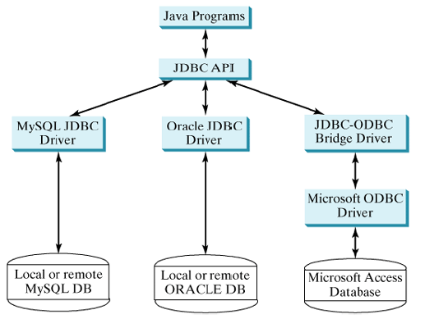
Functions of JDBC
Using JDBC, it is easy to send SQL statements to virtually any relational database.
JDBC makes it possible to do three things:
establish a connection with a database
send SQL statements
process the results

Slide 6
JDBC Class Usage
DriverManager
Driver
loads an appropriate driver
Connection
connects to the database
Statement
creates and executes SQL statements
processes the result using the
ResultSet interface if the
statements return results
ResultSet

Slide 7
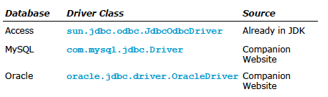
(1) Loading Drivers
Import JDBC Packages import java.sql.*;
Load drivers.
try {
Class.forName(“com.mysql.jdbc.Driver");
} catch (ClassNotFoundException cnfe) {
System.out.println("Error loading driver: " cnfe);
}

Slide 8
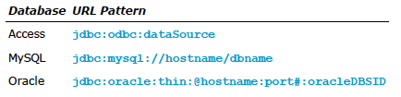
(2) Establishing connections
To connect to a database, use the static method getConnection(databaseURL) in the DriverManager class, as follows:
Connection connection = DriverManager.getConnection(databaseURL);
where databaseURL is the unique identifier of the database on the Internet.
Connection connection = DriverManager.getConnection
("jdbc:mysql://localhost/test" , “username”, “password”);
Database Name

Slide 9
(3) Creating Statements
Select(Retrieve) form DB
Statement stmt = connection.createStatement();
Insert to DB(Update)
PreparedStatement pstmt=connection.prepareStatement(sql);

Slide 10
(4) Executing statements
An SQL update statement can be executed using
executeUpdate(String sql)
it may be create, drop, insert, update, delete etc.
executeQuery(String sql)
to execute SELECT query.
String query="create table Temp (col1 char(5), col2 char(5))”;
pstatement.executeUpdate (query);
ResultSet resultSet = statement.executeQuery ("select firstName, mi, lastName from Student where lastName ” + " = “Smith'" );

Slide 11
(5) Processing ResultSet
The ResultSet maintains a table whose current row can be retrieved
The initial row position is null
Use the next method to move to the next row and the various get methods to retrieve values from a current row
getInt(int columnIndex): return the data of specified column index of the current row as int.
getInt(String columnName): return the data of specified column name of the current row as int.
getString(int columnIndex): return the data of specified column index of the current row as String
getString(String columnName): return the data of specified column name of the current row as String.
column indexes
while (resultSet.next())
System.out.println(resultSet.getString(1) + " "
+ resultSet.getString(2 ) + ". " + resultSet.getString(3 ));
//1🡪 firstName, 2🡪mi, 3🡪lastName

Slide 12
Data Type for create table
JDBC Data Type | Java Type
INTEGER | int
FLOAT DOUBLE | double
VARCHAR CHAR | String

Slide 13
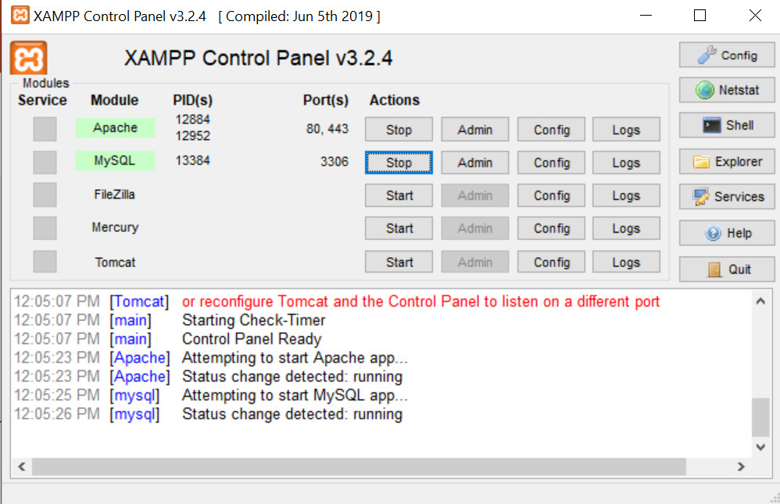
XAMPP

Slide 14
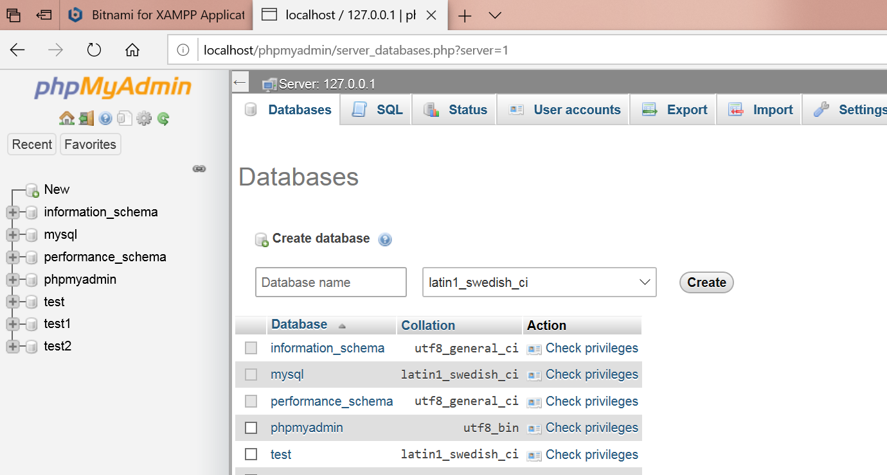
Create DataBase

Slide 15
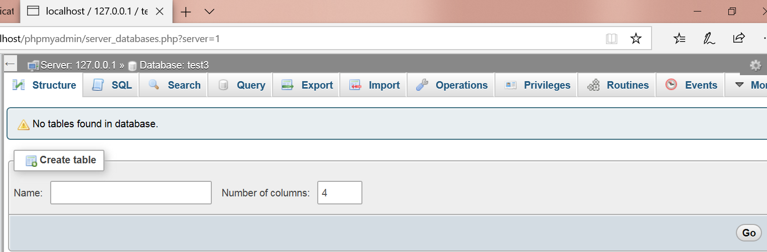
Create TableName and Number of Attributes

Slide 16
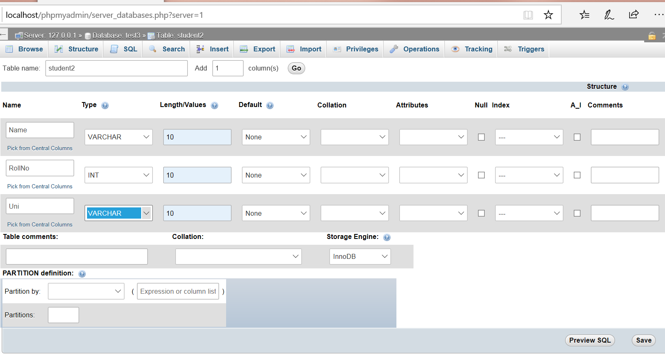
Create Attriblutes Name ,datatype and Length

Slide 17
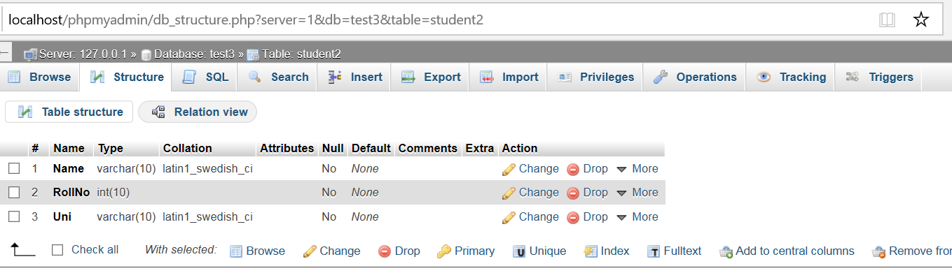
Create table with Attribute Name

Slide 18
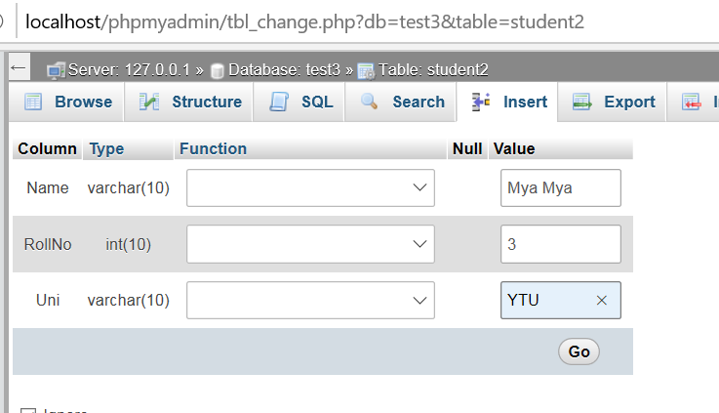
Insert Data

Slide 19
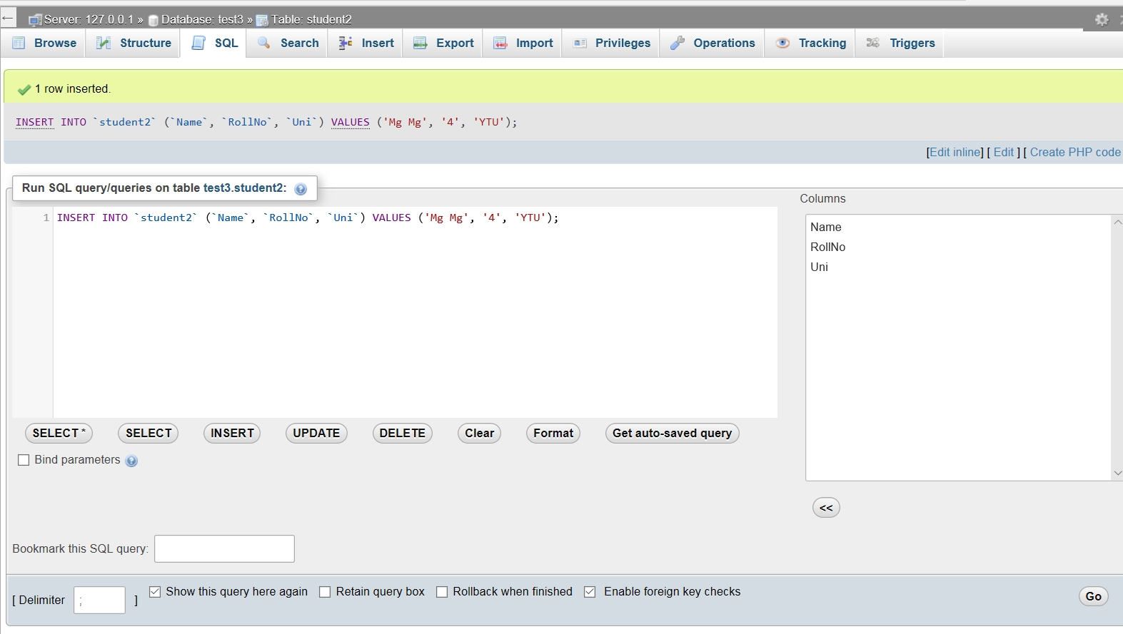
Display data

Slide 20
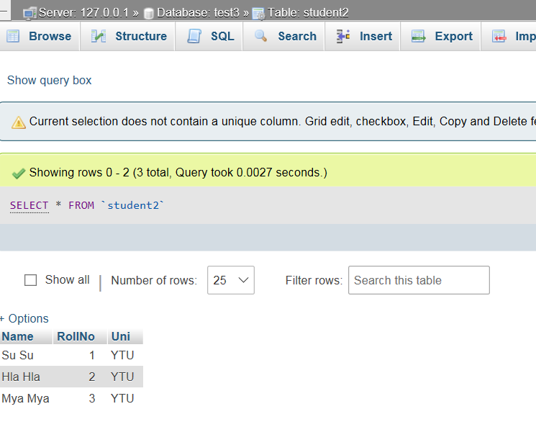

Slide 21
Example 1: Write a program that connects to a local MySQL database
and displays the students table.
import java.sql.Connection;
import java.sql.SQLException;
import java.sql.*;
public class SampleDB {
public static void main(String[] args)throw SQLException, ClassNotFound Exception
{ // Load the JDBC driver
Class.forName("com.mysql.jdbc.Driver");
System.out.println("Driver loaded");
Connection connection = DriverManager.getConnection
("jdbc:mysql://localhost/test3", "root", ""); // Establish a connection
System.out.println("Database connected");
Statement statement = connection.createStatement(); // Create a statement
String sql="select * from student2 "; ResultSet resultSet = statement.executeQuery(sql);

Slide 22
// Iterate through the result and print the student names
while (resultSet.next())
System.out.println(resultSet.getString(1) + "\t" +
resultSet.getInt(2) + "\t" + resultSet.getString(3));
// Close the connection
connection.close();
}
}

Slide 23
Example 2: Write a program that connects to a local MySQL database
and insert data to the students table.
import java.sql.Connection;
import java.sql.SQLException;
import java.sql.*;
public class SampleData {
public static void main(String[] args)throws SQLException, ClassNotFoundException {
// Load the JDBC driver
Class.forName("com.mysql.jdbc.Driver");
System.out.println("Driver loaded");
// Establish a connection
Connection connection = DriverManager.getConnection
("jdbc:mysql://localhost/test3", "root", "");
System.out.println("Database connected");
String sql="insert into student2 (Name,RollNo,Uni)values(?,?,?)";

Slide 24
// Create a statement
PreparedStatement pstatement = connection.prepareStatement(sql);
pstatement.setString(1,"Ma Ma");
pstatement.setInt(2,5);
pstatement.setString(3,"YTU");
pstatement.executeUpdate();
connection.close();
}}

Slide 25
Next Week Lecture
Database
Thank you!

